Slide 1
Online Test Generator System
TS- CC CAPSTONE PROJECT
Presented By:
1. Miss Avantika Wathore– DBATU Maharashtra (BTECH COMP)
2. Miss Janhvi bhute
3. Miss Vidya kale
Guided By: Miss Rashmi Mishra

Slide 2
OUTLINE
Abstract
Problem Statement (Should not include solution)
Aims , Objective & Proposed System/Solution
System Design
System Development Approach(Technology Used)
Flowchart
Images of our website
Conclusion
References
Future Scope

Slide 3
Abstract
Online test generator system website using HTML, CSS, and JavaScript
To create an engaging and interactive user experience for student and teacher.
A modern , active and responsive design.
Adapts to different screen sizes and devices.
Easy access for all student & able to assign test for student.
A user-friendly interface for student to manage and update test in online mode.

Slide 4
The website will also have a feature of question bank .
Allow users to give test for practice according to chapter.
A registration form for student details of login and log out of website so that we can collect data.
A seamless user experience.
Update of question on website into question bank .
Timer for the mcq Test .

Slide 5
Problem Statement
Our university lacks a centralized platform for question bank and the mcq test in timing .
Students, faculty, and staff members are currently relying on google form for mcq test and social media to share the question bank.
Also its impossible for the student to give it to the juniors for practice . So to help juniors we are trying to provide the platform for mcq test and question bank.

Slide 6
Proposed Solution
To create a comprehensive and intuitive online test generator system.
By developing this website, we are giving platform to the faculties for taking students online test within time.
Also providing question bank of each unit of each subject to the students

Slide 7
System Design
The website will be built using HTML, CSS, and JavaScript and will provide the following features:
1. A user-friendly interface that allows student to attempt the test and practice the questions on platform and also manage marks immediately after the test.
2. A searchable subject helps the students to easily go through the each topics of subject.
3. For data storage, uses mysql and for backend , used php to connect database and webdesign .

Slide 8
A logical system is built which fulfils the given requirements
Normally, design is performed in the following in the following two steps:
Primary Design Phase: In this phase, the system is designed at block level. The blocks are created on the basis of analysis done in the problem identification phase.Thus, all activities which require more interaction are kept in one block.
Secondary Design Phase: The detailed design of every block is performed

Slide 9
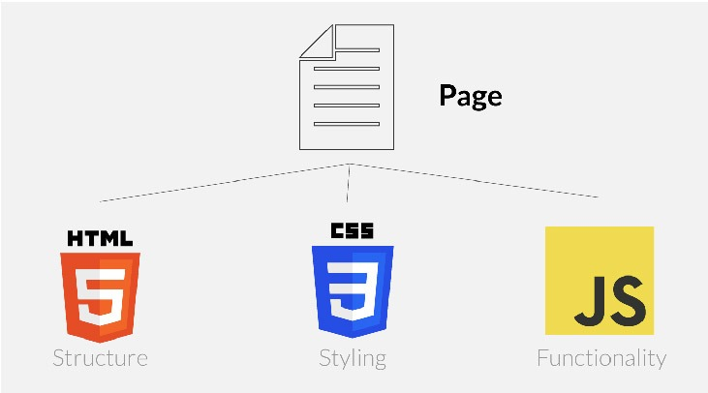
System Development Approach
HTML provides the basic structure of sites, which is enhanced and modified by other technologies like CSS and JavaScript.
CSS is used to control presentation, formatting, and layout.
JavaScript is used to control the behavior of different elements.

Slide 10
Flowchart
Start
Is registered?
Attempt
test
Show marks
End
Registration successful
Open Question bank
login
View subjects
Authentication

Slide 11
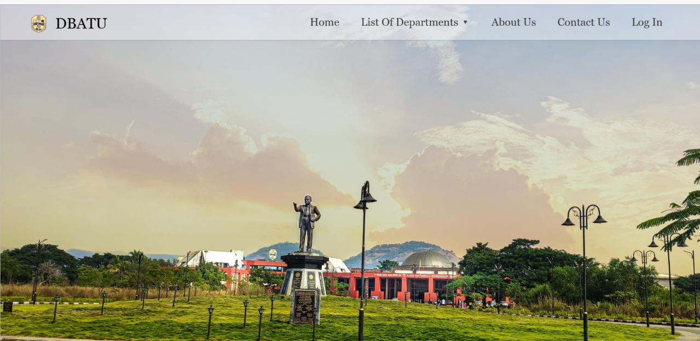
Images of our website

Slide 12
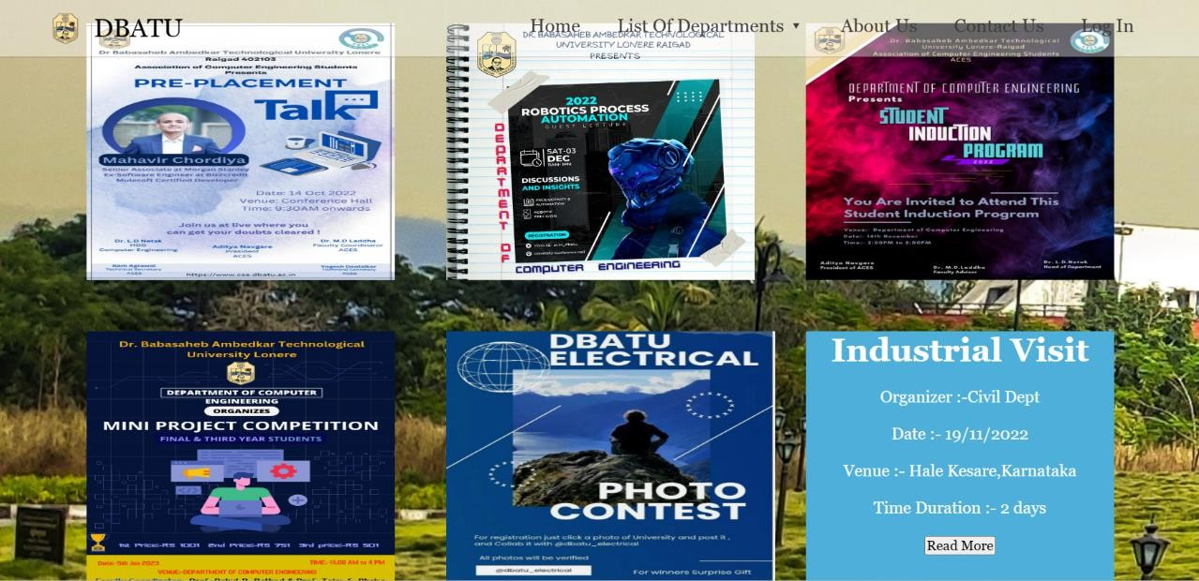

Slide 13
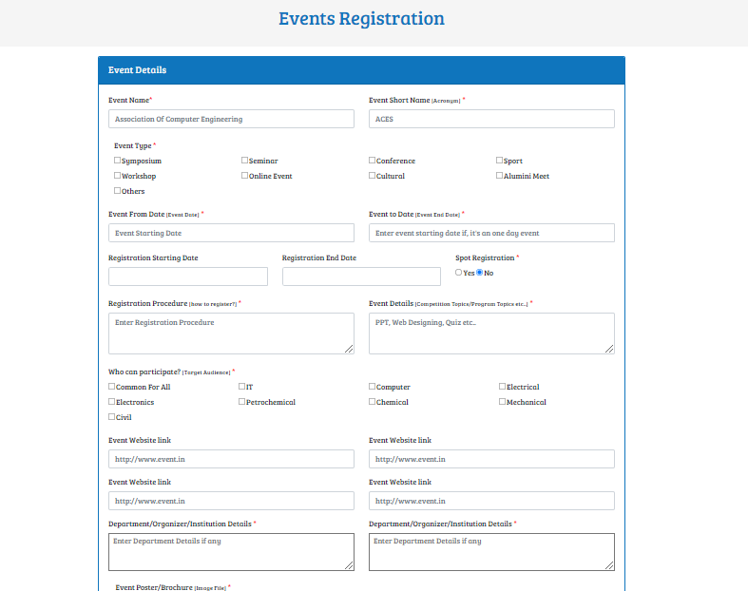

Slide 14
Conclusion
In conclusion, developing an event management website for our university will provide a centralized platform for managing and promoting online tests and questions according to the subjects .
Enhance communication and engagement among students, faculty, and staff with features such as a user-friendly interface, searchable subjects question bank and mcq’s in online system.
Ultimately contribute to a vibrant campus community and a positive university experience for all by facilitating easy access to test attempt and encouraging students to practicing the topics.

Slide 15
References
HTML 5 Black Book (Covers CSS3, JavaScript, XML, XHTML, AJAX, PHP, jQuery)
Responsive Web Design with HTML5 and CSS by Ben Frain
HTML, CSS, and JavaScript All in One
Php and mySql for databases.
https://www.w3schools.com
https://www.geeksforgeeks.org
https://www.javatpoint.com

Slide 16
Future Scope
There are several potential future scope for the online test generator system website developed for the university using HTML, CSS, JavaScript and php. Some of these include:
Random question test: The website contain the lots of question and that question can be randomly assign in the test according to the test marks.
Repetition of question in test : Repetition of question during the test can be avoid using the problem solving method.
Creating databases for particular student who took the exam of particular subject of semester .

Slide 17
Online courses for student :Teacher can also do the streaming the lecture and able to upload on the website only for dbatu students.
Teacher able to take exams CA: In the dbatu university ,teacher able to take exams in timing using this platform and able to provide practice sets to the student .

Slide 18
THANK YOU

